Slide 1

Moneyball Part Deux
How to get the Colorado Rockies to the World Series

Slide 2




Team
Liz Cooney
Howard Dixon
Cassy Miller
Sandokan Stage

Slide 3
1
2
3
4
5
6
Introduction:
Team
Executive Summary
Data Overview + Approach
Questions
Batting:
Overview
Analysis
Pitching:
Overview
Analysis
Fielding:
Overview
Analysis
Appearance:
Overview
Analysis
Results:
Overview
Next Steps and Future Questions
AGENDA

Slide 4
Executive Summary
Objective
This analysis seeks to rejuvenate the Colorado Rockies by applying a "Moneyball" strategy, which involves a rigorous statistical analysis comparing the current players' performance metrics with those of the 2007 World Series team. By meticulously evaluating player statistics and identifying critical performance indicators, we aim to pinpoint strengths and weaknesses in the current lineup. Through this process, we will recommend targeted changes such as potential trades or acquisitions to optimize team composition and improve overall performance.
Our objective is to strategically position the Rockies for a return to the World Series, drawing on historical successes of the 2007 team and modern analytics to guide our decisions. With a focus on continuous monitoring and adaptive strategies, we envision a revitalized team that excels in the competitive landscape of Major League Baseball.

Slide 5
Executive Summary
Data Overview and Approach
Data was collected for the Rockies 2007 and 2024 rosters from Baseball Reference resource online. The team both scraped tables from the website and downloaded excel documents to perform our analysis.
The team took a 4-pronged approach to dividing and reviewing the data. Each team member looked at a specific subset of player statistics, including batting, pitching, and fielding. Additionally our team looked at appearance and salary data to help us determine whether certain players contribute their “worth” to the Rockies.
Each team member performed several statistical analysis and visualizations to better understand how the 2007 and 2024 teams performed relative to each other and identify areas for the 2024 Rockies to improve.

Slide 6
Executive Summary
Questions to Answer
How do the batters in 2024 compare to 2007, and what needs to change in order to improve the team?
How do Starting Pitchers, Relief Pitchers, and Closing Pitchers in 2024 compare to the 2007 roster, and what needs to change in order to improve the team?
How do does the Rockies fielding compare between the 2007 and 2024 seasons?
What changes should be made to the 2024 Rockies player roster to get them to the World Series?

Slide 7
Batting
How do the batters in 2024 compare to 2007, and what needs to change in order to improve the team?
We will look at:
On Base Percentage (OBP)
Runs Batted In (RBI)
Runs and Hits

Slide 8
On Base Percentage (OBP)
Measures how often a batter reaches base through hits, walks, or by being hit by pitch, relative to their total number of opportunities to bat.
Getting on base is crucial to creating scoring opportunities.
Higher OBP indicates a more effective batter who helps create scoring opportunities.
The main statistic used in the Moneyball model is On Base Percentage.

Slide 9
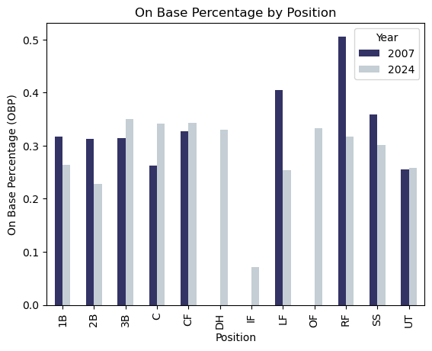
OBP
Nearly every position in 2007 had a higher OBP and RBI than 2024.
Significant OBP differences specifically for Left Fielders and Right Fielders between 2007 and 2024.

Slide 10
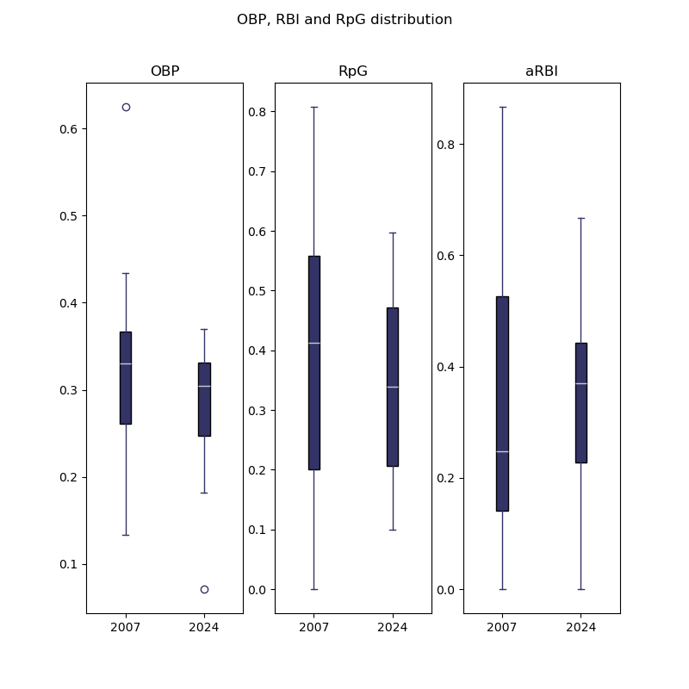
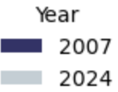
OBP, RpG, RBIs.
The median OBP is slightly higher in 2007 v 2024. (33% v 30%).
RpG and RBIs also are higher distributions in 2007 compared to 2024.
Median aRBI is much lower in 2007 suggesting that the Rockies are concerned less with getting on base and more focused on power hitting.

Slide 11
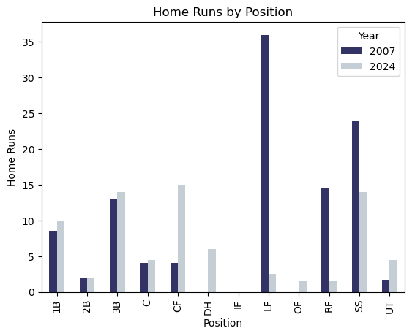
Home Runs

Slide 12
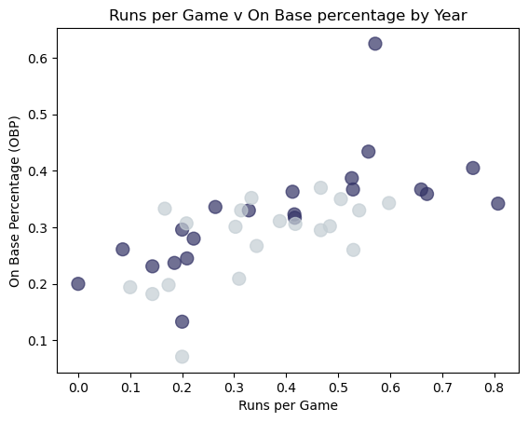
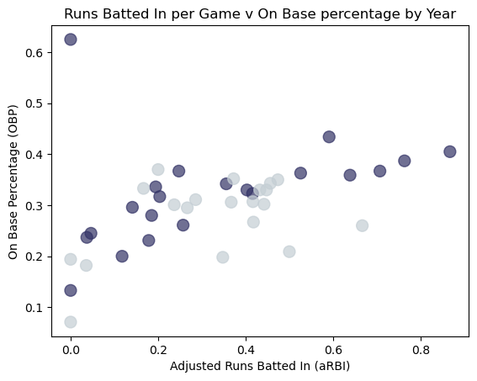
OBP

Slide 13
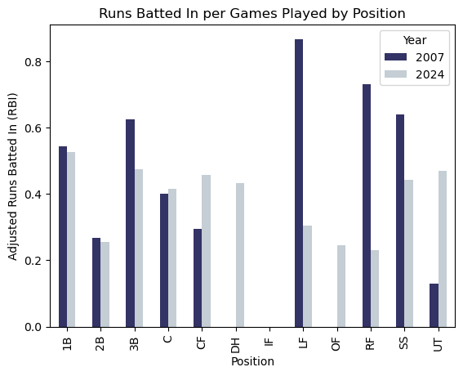
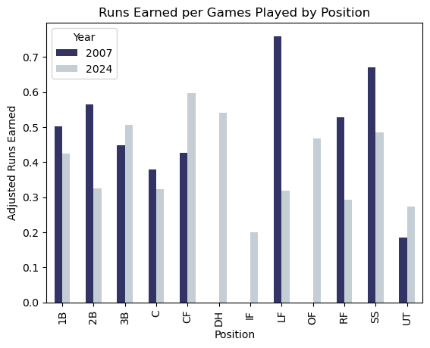
Runs and RBIs

Slide 14
Conclusion:
OBP OBP OBP OBP OBP OBP OBP
OBP is an important statistic resulting in an overall better performing team. Therefore, the Rockies need to prioritize this and re-establish this strategy in order to be closer to a chance at the World Series.
Prominent positions of struggle include Outfielders (Left and Right) and ShortStop. Replacing these players with those who have better OBPs is recommended.

Slide 15
Pitching
How do Starting Pitchers (SP), Relief Pitchers (RP), and Closing Pitchers (CL) in 2024 compare to the 2007 roster, and what needs to change in order to improve the team?
We will look at:
Average Win-loss ratio
ERA
Strike-outs to Balls ratio

Slide 16
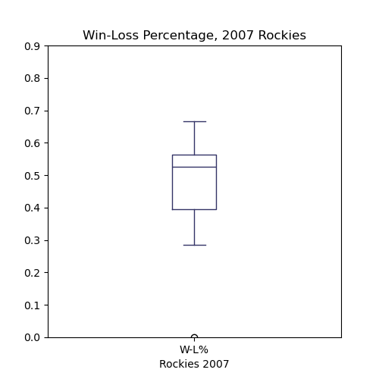
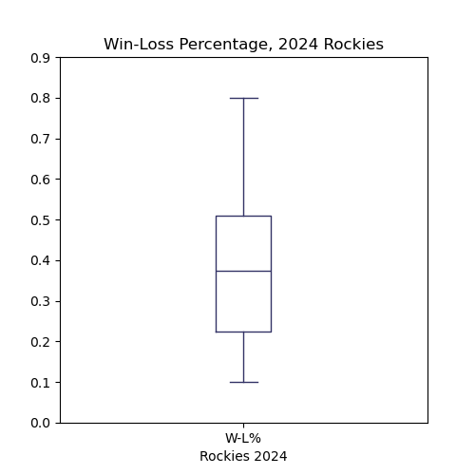
Pitchers’ Win-Loss Percentage per Season
Rockies 2007 median
Rockies 2007 median
Rockies 2024 median
Rockies 2024 median

Slide 17
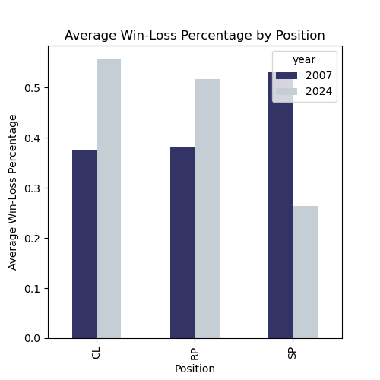
Average Win-Loss %
The win-loss ratio is calculated by dividing the number of wins by the total number of decisions (wins + losses). Higher scores are better, indicating a pitcher’s ability to win games.
2024 CL and RP position appears to perform better in terms of their win-loss percentage. However, this is may be misleading because the 2024 team has played fewer overall games so far, when compared to the 2007 team.
CL and RP players also play fewer games than the starting pitchers.

Slide 18
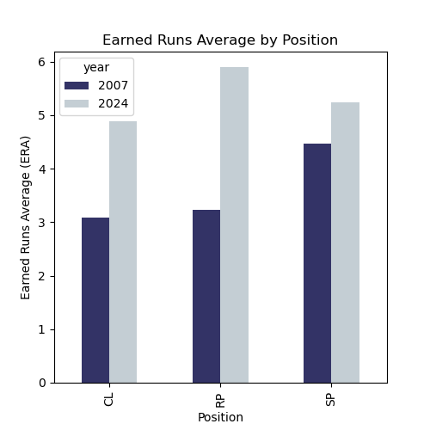
Earned Runs Average (ERA)
Earned runs are runs that score due to the pitcher's performance, excluding unearned runs that result from errors, passed balls, etc
2007 lineup allowed fewer earned runs.
2024 RP and CL positions perform worse relative to SP.
The average Earned Run Average for 2007 team was 3.89, while in 2024, the Earned Run Average for the team is 5.44.

Slide 19
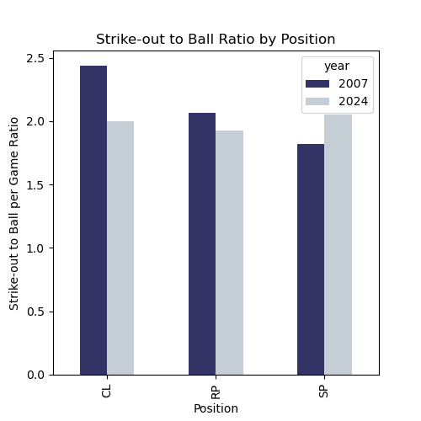
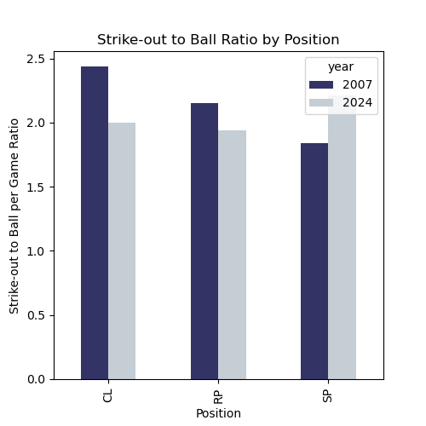
Strike-Out to Balls Ratio (K/BB)
The Strike-out to Balls ratio is considered one of the best indicators of a pitcher's control and ability to miss bats. The higher score, the better. 3.0 ratio is considered ideal.
2007 CL and RP positions have more strikeouts than walks per game on average than the 2024 season.

Slide 20
1
2
“How do Starting Pitchers, Relief Pitchers, and Closing Pitchers in 2024 compare to the 2007 roster, and what needs to change in order to improve the team?”
2007 pitching roster out-performed the 2024 team in terms of:
Preventing earned runs
Striking-out batters and reducing the number of walks.
2024 closing pitchers and relief pitchers performed worse relative to the 2007 roster.
2024 starting pitchers showed fewer deficiencies regarding Home Runs Allowed, ERA and Strike-out to Ball Ratio.
Recommendation:
Improving ERA and K/BB Ratio, while focusing on identifying CL and RP players for trades
CONCLUSIONS - PITCHING

Slide 21
Fielding
How do does the Rockies fielding compare between the 2007 and 2024 seasons?
We will look at:
Fielding Percentage
Errors
Putouts
Chances to Errors

Slide 22
Fielding Percentage (Fld%)
Fielding percentage, also known as fielding average, is a statistic in baseball that measures a team's defensive efficiency. It is calculated as the sum of a team's putouts and assists divided by the sum of putouts, assists, and errors. The formula Fielding Percentage is calculated as (Assist + Putouts) / (Assists + Putouts + Errors).
A higher fielding percentage indicates better defensive performance, as it reflects a team's ability to successfully make plays without committing errors.
Fielding is a critical component to reducing scoring opportunities for your opponent.

Slide 23
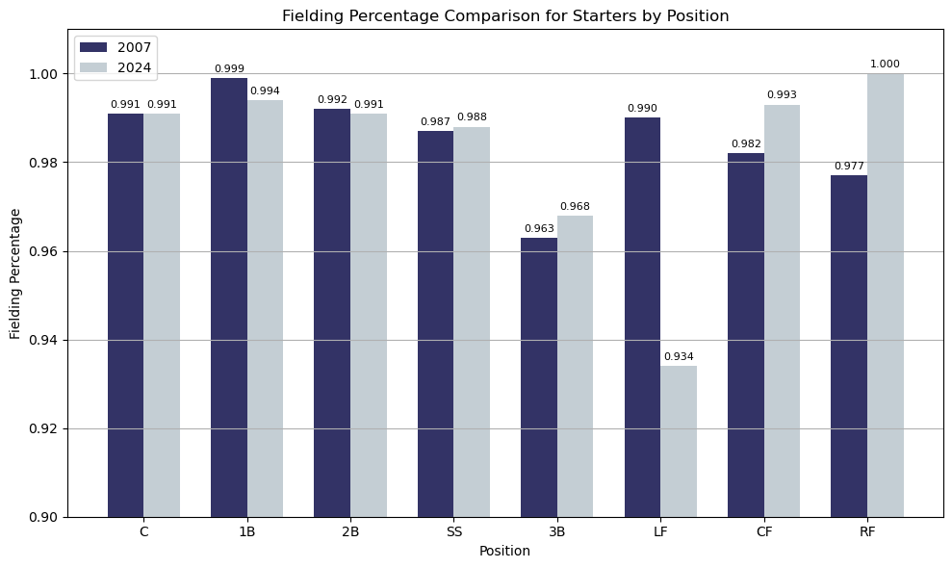
Fielding Percentage (Fld%)
A baseball player's fielding percentage is calculated similarly to that of a team's. It measures an individual player's defensive efficiency, at their relative position.
Fielding Percentage for Rockies starters by position are relatively close across both seasons, except for Left Field

Slide 24
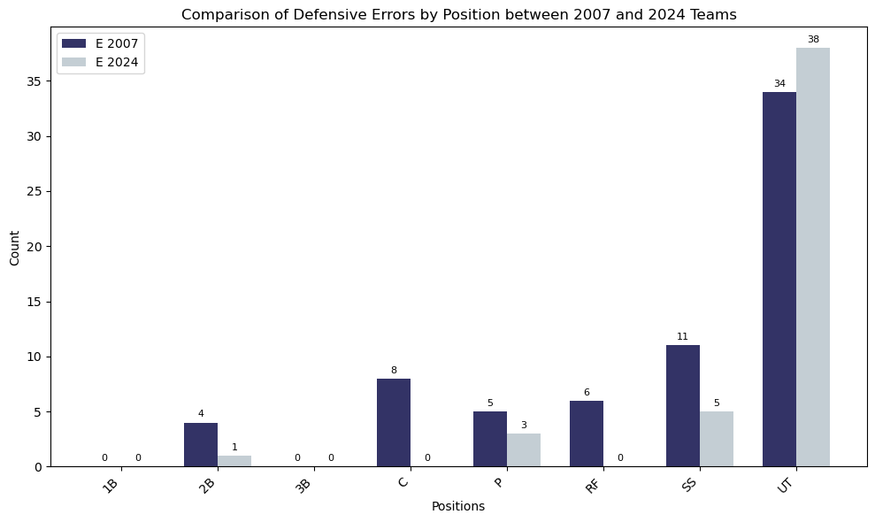
Comparison of Errors by Position
Errors by position in baseball represent the defensive mistakes made by players at specific positions on the field. Each position on a baseball team has unique responsibilities and challenges, and tracking errors by position helps to evaluate the defensive performance of players in their specific roles.
Review of errors by position were relatively close across both the 2007 and 2024 seasons.

Slide 25
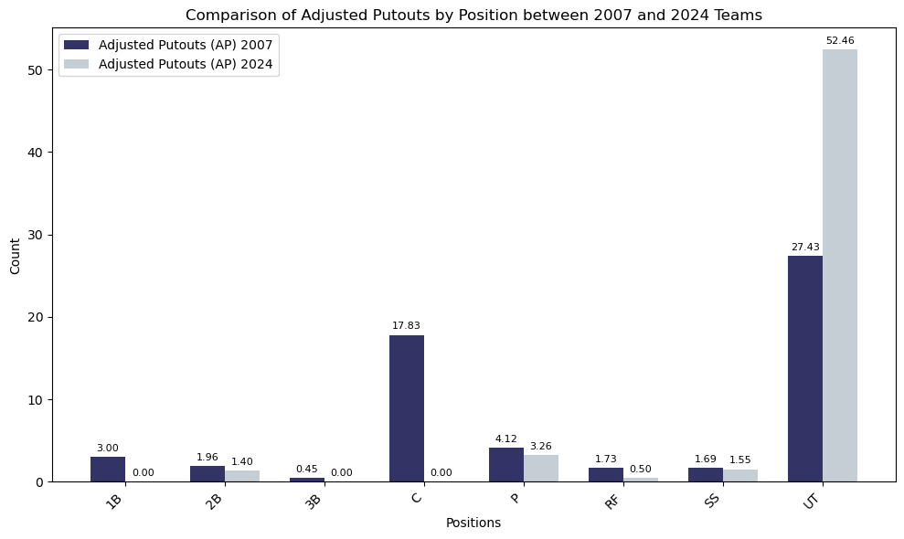
Comparison of Putouts by Position
A putout (PO) is a statistic credited to a defensive player who is directly responsible for completing an out. The way putouts are recorded usually varies by position, reflecting the different roles and responsibilities of each defensive position.
The number of putout were reasonably close except for the position of Utility Fielder (UT).

Slide 26
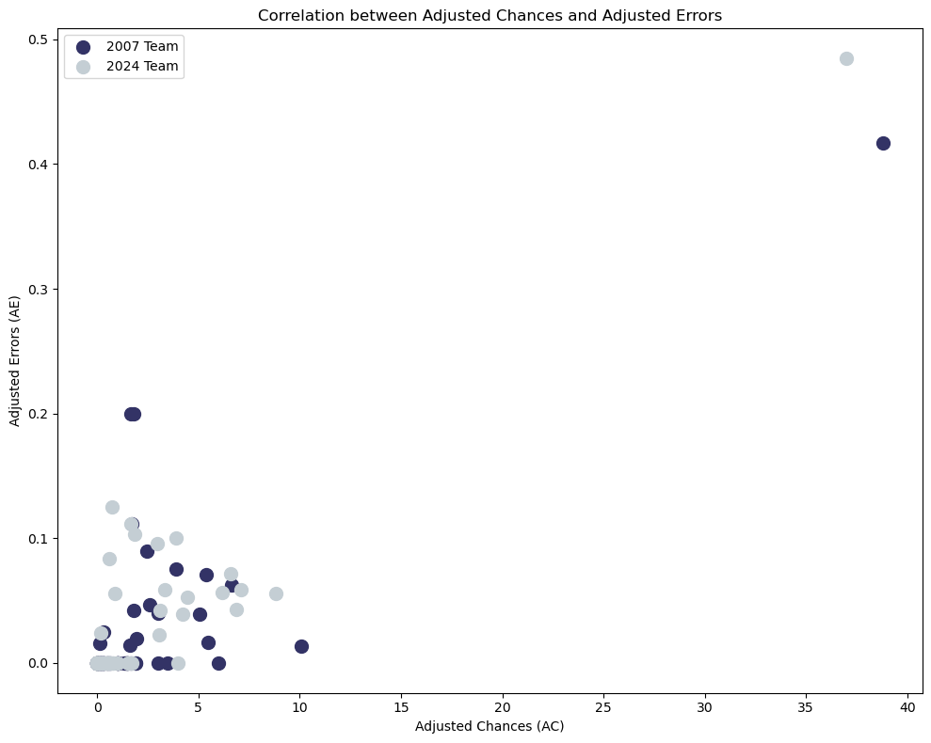
Correlation of Chances to Errors
The correlation between chances and errors can provide insight into a player's or a team's defensive reliability and workload.
There is a high positive correlation between the 2007 and 2024 team when it came to the number of chances to the amount of errors committed. This might suggest that as a player or team gets more defensive opportunities, the number of errors also increases.

Slide 27
1
“How does the fielding of both pitchers and positional players in 2024 compare to that of the 2007 World Series team, and what needs to change in this area to help the Rockies improve?
The 2007 roster surpassed the 2024 team in terms of:
Team fielding by position especially in Left Field
Number of errors committed
Recommendation:
Improving the quality of play for the Left Field position, while focusing on trades or calling up someone from the minors to fill the position.
CONCLUSION - FIELDING

Slide 28
Appearances
What changes should be made to the 2024 Rockies player roster to get them to the World Series?
We will look at:
Distribution of Salary & WAR by year
Clustering of Players based on salary and WAR
WAR by Position and Year

Slide 29
Roster comparison 2007 vs 2024
WAR, or Wins Above Replacement, is an advanced baseball statistic that attempts to summarize a player's total contributions to their team in one number. It measures the number of additional wins a player provides compared to a replacement-level player, which is a hypothetical average player who could be obtained at minimal cost (such as a minor league player or a free agent).
WAR takes into account various aspects of a player's performance, including:
Batting: Measures a player's offensive contributions, such as hitting for average, power, and drawing walks.
Base Running: Accounts for a player's ability to steal bases and take extra bases.
Fielding: Evaluates a player's defensive contributions, including their range and ability to make plays.
Pitching: For pitchers, WAR considers their ability to prevent runs.
WAR is calculated differently for position players and pitchers, and different organizations (like Baseball-Reference and FanGraphs) have their own formulas for computing WAR.

Slide 30
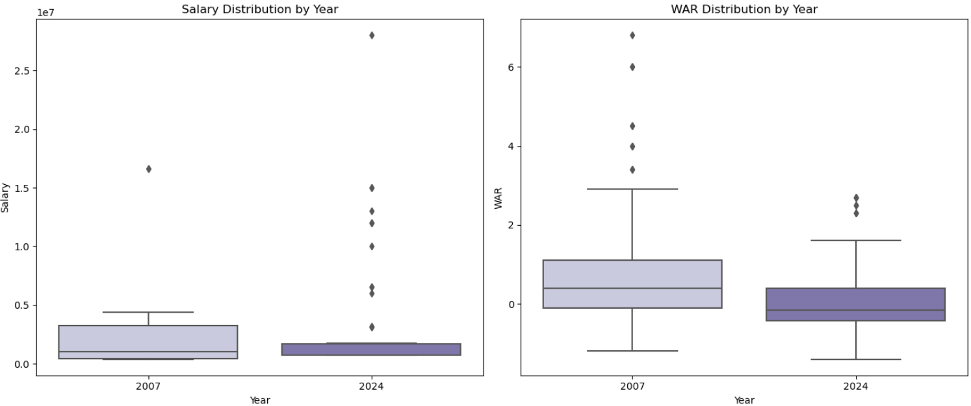
Salary Distribution vs WAR Distribution by year
2007 Data:
Salaries: Generally lower compared to 2024.
WAR Values: More evenly distributed, with fewer outliers and a balanced spread across the roster.
Callouts: Most players were likely paid less but contributed a solid performance to the team. The 2007 roster made it to the World Series, indicating a good return on investment.
2024 Data:
Salaries: Noticeably higher overall.
WAR Values: Higher variability with more significant outliers, indicating some players have much higher or lower performance compared to others.
Callouts: Some high-paid players have low WAR, indicating overpayment and underperformance. Conversely, there may be underpaid but highly performing players, showing possible inefficiencies in salary allocation.

Slide 31
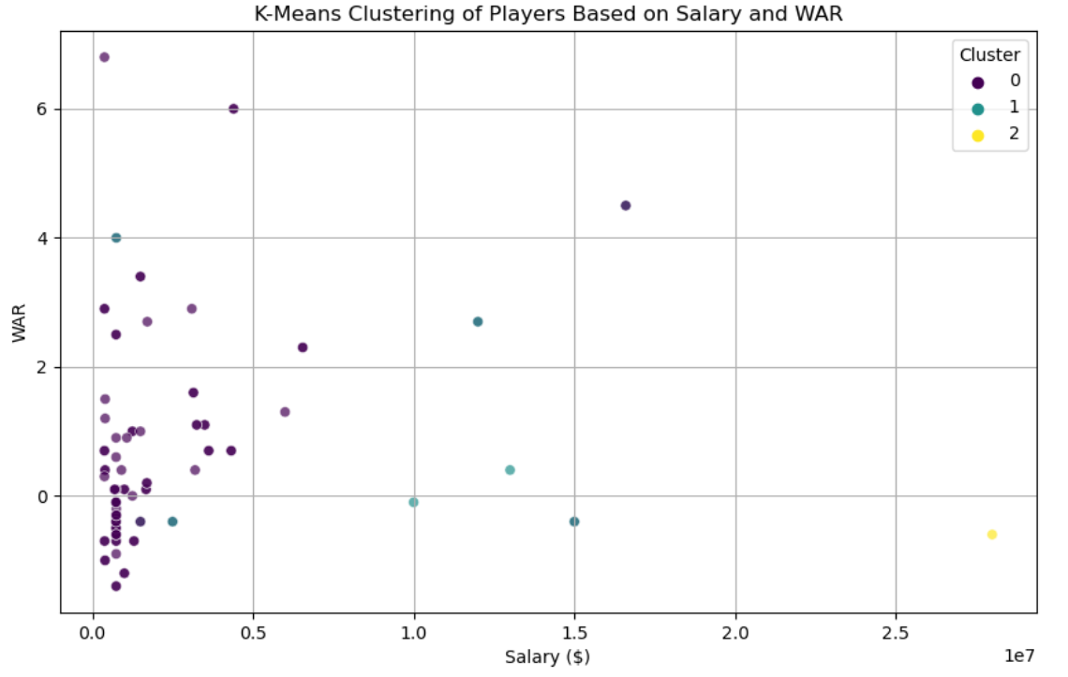
WAR vs Salary
2007 Roster: Showed a good balance with clusters indicating fair compensation for performance and potential growth areas.
2024 Roster: Showed more inefficiencies with a significant cluster of overpaid underperformers, highlighting the need for strategic adjustments in salary allocation and player performance improvement.

Slide 32
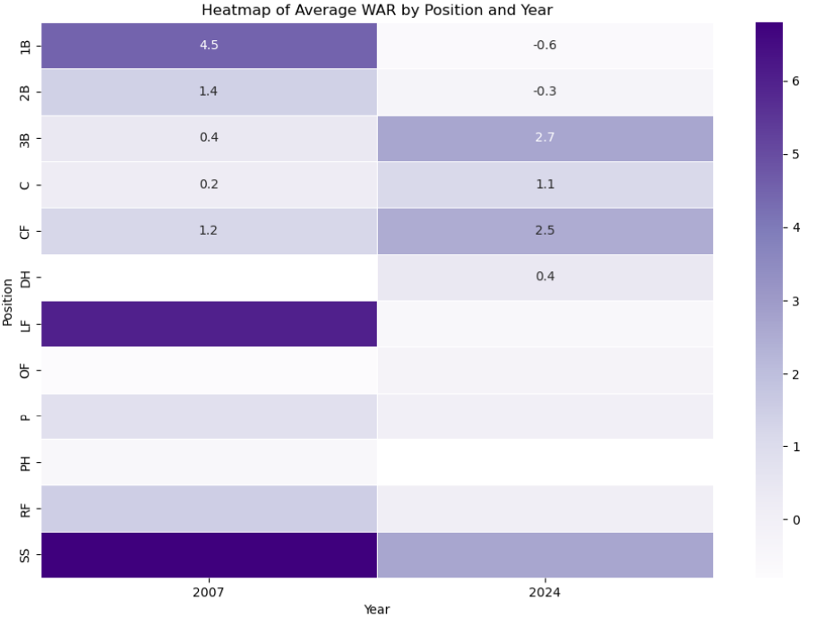
Avg. WAR by Position and Year
Improved Infield Performance (2024):
The infield positions (1B, 2B, SS, 3B) in 2024 show a marked improvement in average WAR compared to 2007. This suggests strategic improvements in player acquisition or development for these positions.
Decline in Outfield Performance (2024):
The outfield positions (LF, CF, RF) show a decline in average WAR in 2024 compared to 2007. This indicates a need to reassess the outfield roster and make improvements either through player development or acquisitions.

Slide 33
Conclusion
Observations and Recommendations
After thoroughly analyzing the Colorado Rockies' 2007 World Series team against the current 2024 roster, several key areas have emerged where improvements are crucial for a successful return to the postseason. The 2007 team was distinguished by its higher on-base percentage (OBP) and more effective pitching, notably in terms of earned run average (ERA) and strikeout-to-walk ratios. In contrast, the 2024 Rockies struggle with a lower OBP and have shown deficiencies in pitching, particularly in ERA and strikeout performance.
For the Rockies to regain their competitive edge, the focus should be on improving their OBP, especially in positions where the current roster is underperforming, such as the outfield and shortstop. Seeking trades or acquisitions for players with strong OBP metrics can address these gaps. Additionally, the pitching staff needs attention; improving ERA and the strikeout-to-walk ratio is essential. This may involve targeting new pitchers or optimizing the performance of current players.
The analysis also highlights that while infield positions have shown improvement in WAR (Wins Above Replacement) compared to 2007, the outfield positions have declined. This suggests a need for strategic adjustments either through player development or new acquisitions. Addressing these areas will help the Rockies realign with the successful strategies of the 2007 team and put them on a stronger path toward another World Series appearance.

Slide 34
Thank you!
Q&A

Slide 35
Sources
Data was pulled from tables located on www.baseball-reference.com:
"https://www.baseball-reference.com/teams/COL/202
"https://www.baseball-reference.com/teams/COL/2024.shtml#team_pitching"4.shtml#team_batting"
"https://www.baseball-reference.com/teams/COL/2024-fielding.shtml#standard_fielding"
"https://www.baseball-reference.com/teams/COL/colorado-rockies-salaries-and-contracts.shtml#payroll"
"https://www.baseball-reference.com/teams/COL/2024-batting.shtml#players_value_batting"
"https://www.baseball-reference.com/teams/COL/2024-batting.shtml#players_cumulative_batting"
"https://www.baseball-reference.com/teams/COL/2024.shtml#appearances"
"https://www.baseball-reference.com/teams/COL/2024.shtml#players_value_pitching"
"https://www.baseball-reference.com/teams/COL/2007.shtml#team_batting"
"https://www.baseball-reference.com/teams/COL/2007.shtml#team_pitching"
"https://www.baseball-reference.com/teams/COL/2007.shtml#standard_fielding"
"https://www.baseball-reference.com/teams/COL/2007.shtml#appearances"
"https://www.baseball-reference.com/teams/COL/2007.shtml#coaches"
"https://www.baseball-reference.com/teams/COL/2007.shtml#players_value_batting"
"https://www.baseball-reference.com/teams/COL/2007.shtml#players_value_pitching"

Slide 36
Appendix

Slide 37
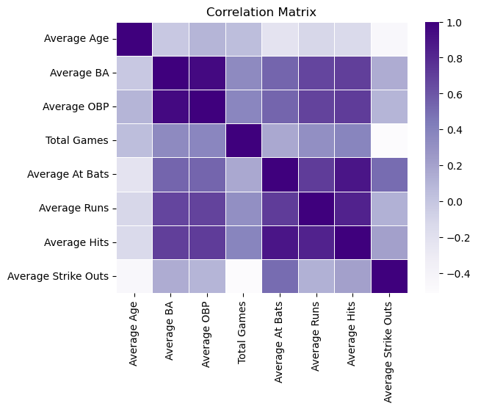
Correlation
Obvious correlations
I.e. OBP to BA, Hits and At Bats etc.
Big focus on how average hits correlate to runs earned.
Getting on base earns runs.
Batting

Slide 38
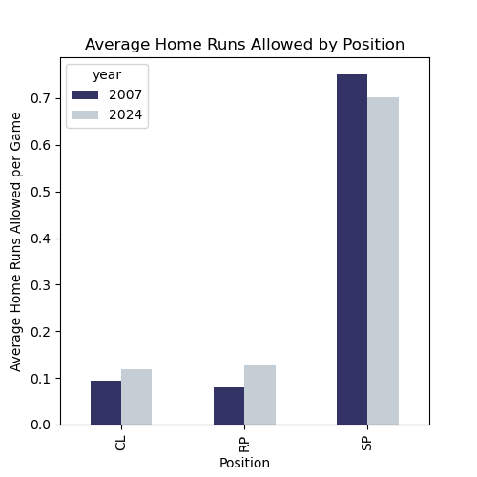
Home Runs Allowed (HR)
PITCHING
Home runs allowed refers to the number of times a pitcher has given up a home run to an opposing batter.
There are nearly negligible differences in performance between 2007 and 2024 teams. However, CL and RP positions perform modestly worse in 2024, and have played fewer games in their season so far.

